Slide 1
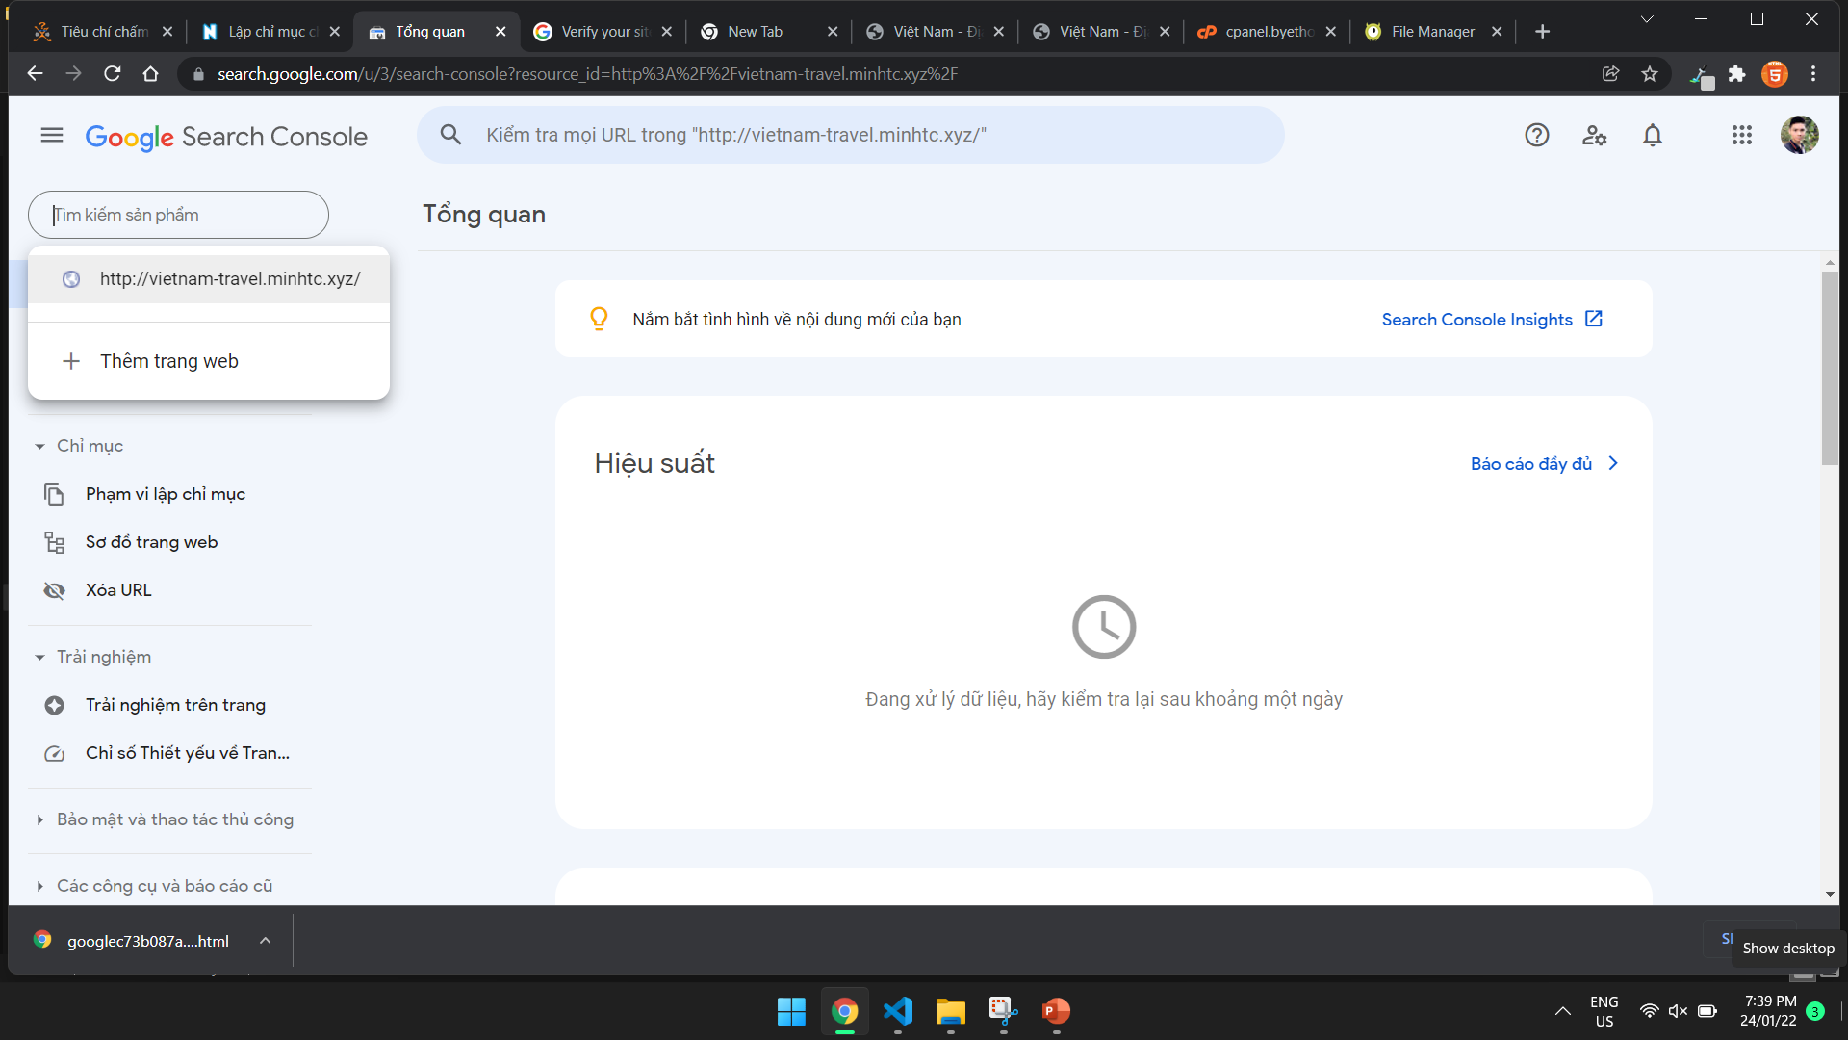

Slide 2
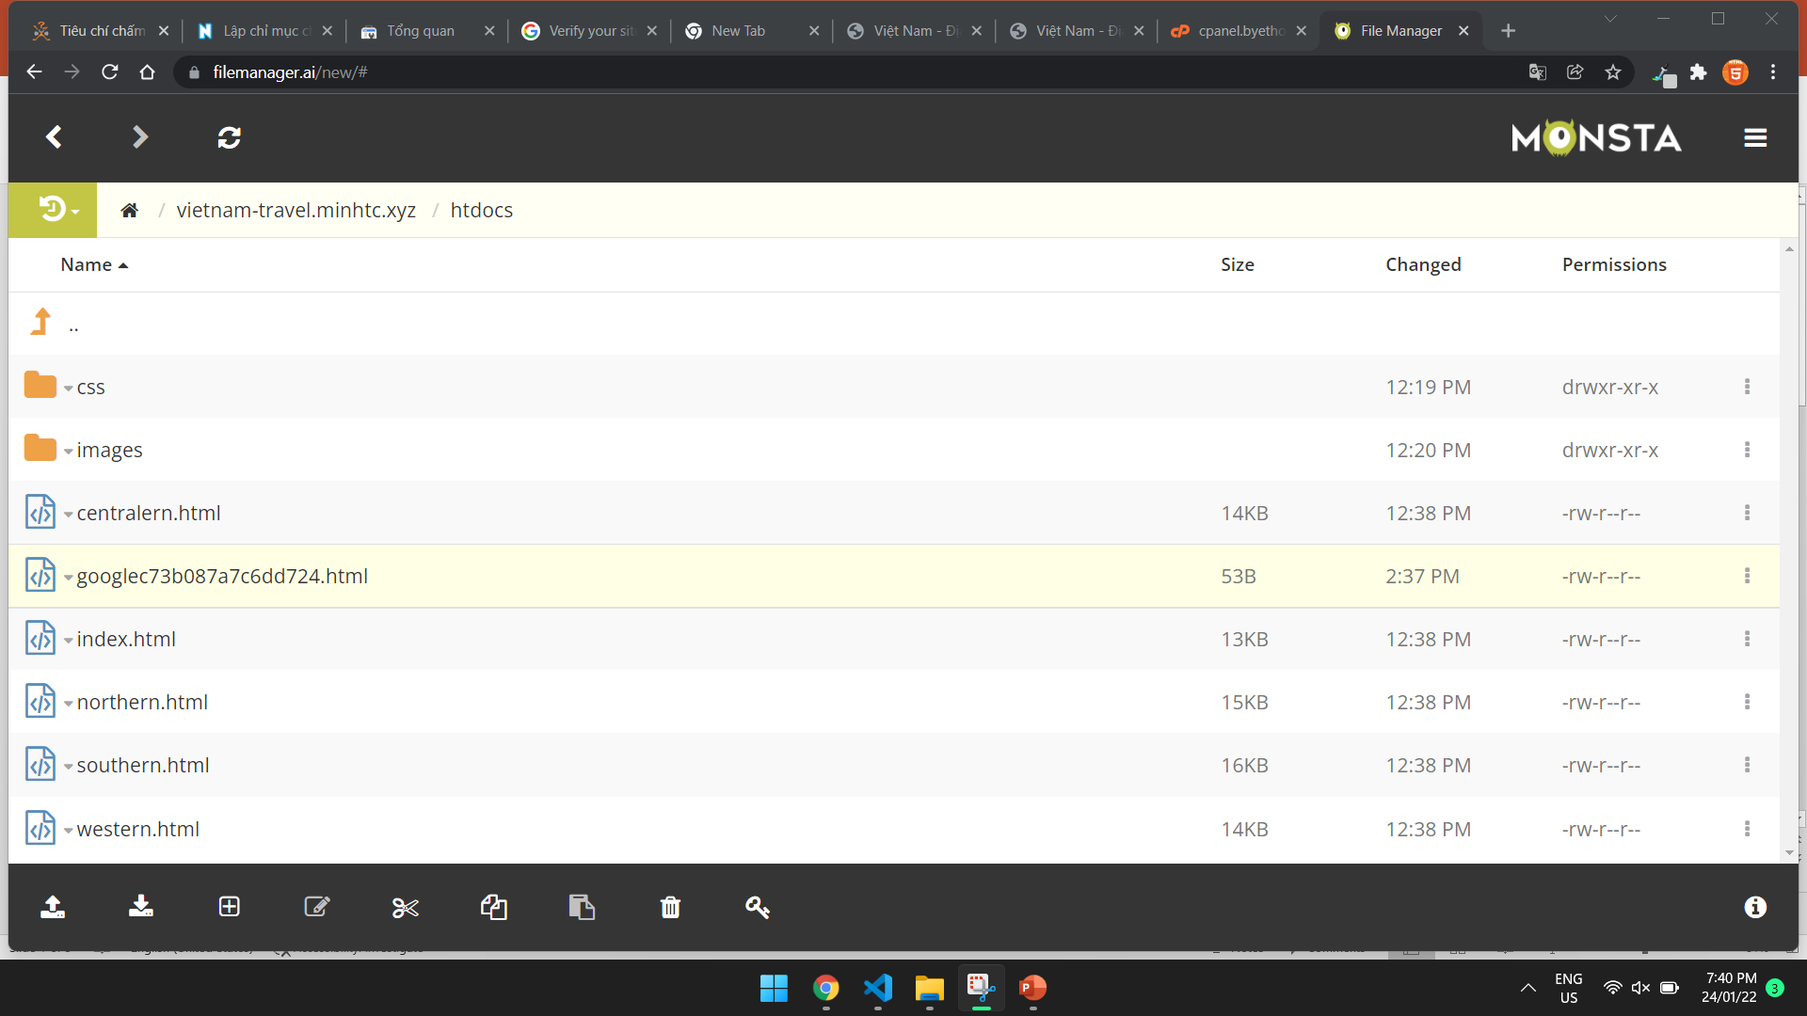

Slide 3
Gmail: minhtcfx15113@funix.edu.vn
Login
http://www.google.com.vn/webmasters/

